Slide 1
Open Source’s Role in CONNECTing the
Public and Private Sector Healthcare Communities
David Riley, CONNECT Lead
FHA, Contractor
OSCON, July 21

Slide 2

A Nation’s Call to Action
“We’ll be on our way to computerizing all of America’s medical records, which won’t just eliminate inefficiencies, save billions of dollars and create tens of thousands of jobs – but will save lives by reducing deadly medical errors.”
– President Barack Obama, February 4, 2009

Slide 3
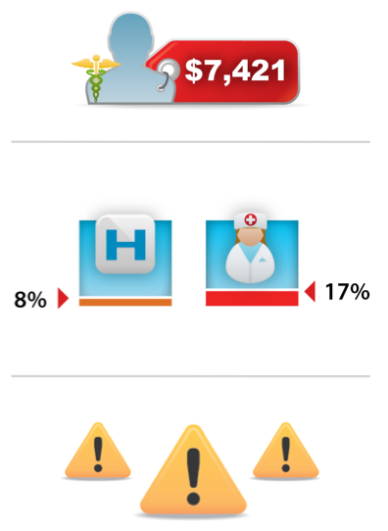
The Current State of Affairs: A Disjointed, Expensive Healthcare System
U.S. spent approx. $2.2 trillion on health care in 2007 ($7,421/person). This comes to 16.2% of GDP, nearly twice the average of other developed nations. (Source: www.whitehouse.gov)
Only about 8% of the nation's 5,000 hospitals and 17% of its 800,000 physicians currently use the electronic health record (EHR) systems envisioned for the whole nation. Most of today’s systems are still not interoperable. (Source: CNN)
Due to lack of interoperable EHRs, tests are duplicated, information is unavailable at the point
of care, public health information is difficult to track and health organizations carry a heavy administration burden.

Slide 4

The National Health IT Agenda
The American Recovery and Reinvestment Act (ARRA) invests $19 billion in computerized medical records that will help to reduce costs and improve quality while ensuring patients’ privacy.
ARRA promotes the national agenda by helping:
Increase access to care
Improve quality of care
Decrease the costs of care
Promote meaningful use of EHRs
ARRA and the President’s reform agenda focus on building
open and transparent government.

Slide 5



























Federal Health Architecture
Advancing the Agenda
c
FHA ensures federal participation in ONC-led initiatives such as the NHIN,
NHIN Direct, EHR adoption, and CONNECT
E-gov initiative managed by ONC within HHS • 26+ federal agencies participate in FHA
Notes:
Verify all logos are current

Slide 6


CONNECT
Meeting Multiple Objectives
CONNECT promotes the widespread adoption of interoperable health IT.
It uses nationally recognized standards, conventions and trust agreements, to address multiple complex objectives simultaneously.
CONNECT is a federally funded, Open Source software solution that is a:
Platform for Participation
Platform for Innovation
Reform Objectives
Meaningful Use Objectives
Transparent Government Objectives

Slide 7




NHIN Exchange and CONNECT
The Nationwide Health Information Network (NHIN) is a set of standards, services, and policies that enable secure health information exchange over the internet.
NHIN Exchange connects a diverse set of federal agencies and private organizations to securely exchange electronic health information using the NHIN services. (For example: SSA – MedVirginia, DoD, VA and KP)
CONNECT is a federally funded and developed open source reference implementation of the NHIN Exchange standards and services.
  CONNECT is using an effective public – private collaboration to create a secure, standard platform for health information exchange
  NHIN Exchange participants save resources by using CONNECT instead of developing their own implementation of the NHIN Exchange standards and services

Slide 8
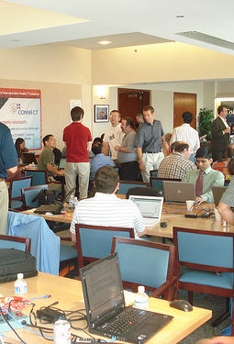
CONNECT and Open Source
CONNECT Code is Released Under
the New BSD License
Release as Open Source April 2009
CONNECT Open Source Community Announcement June 2009
CONNECT Community Events
  CONNECT Training Seminars/Webinars
  CONNECT Code-A-Thons
CONNECT Community Focus
  Getting organizations into production exchanging health information
    NHIN Exchange based production
    Non-NHIN Exchange based production

Slide 9

NHIN/CONNECT Implementation Status
Federal Adopters
Test/Demo
Production
Centers for Disease Control & Prevention
Centers for Medicare & Medicaid Services
OFM (esMD)
OCSQ (PQRI)
OCSQ (C-HIEP)
CMSO (MITA Claims Submission)
Department of Defense
Department of Homeland Security
Department of Veterans Affairs
Food and Drug Administration
Federal Communications Commission
Indian Health Service
National Cancer Institute
National Disaster Medical System
Social Security Administration
2010*
2010*
2010*
2010*
2010*
2010*
2010*
2010-2011*
2010-2011*
2010*
2010
2009
2010*
2010*
2009
CONNECT and NHIN
* Planned
Notes:
9

Slide 10

NHIN/CONNECT Implementation Status
Non-Federal Adopters
Test/Demo
Production
Center for Healthy Communities, Wright State University, Healthlink
Central Virginia Health Network/MedVirginia
Community Health Information Collaborative (CHIC)
Emdeon
EPIC
HealthBridge
Indiana State Department of Health
Iowa Department of Public Health
Iowa Health Systems
Kaiser Permanente
MedVirginia
MEDNET in Partnerships
Community Health Information Collaborative (aka HIE-Bridge)
LACIE –Lewis and Clark Information Exchange
Emdeon
Hielix – Phase 1 Contract for the State of North Dakota Statewide HIE
New York State Department of Health
Orange County ER Connect
Redwood MedNet
Regenstrief Institute, Inc.
Southeastern Michigan Health Association
Thayer County Health Services
Washington State Department of Health
2010*
2010*
2009
2010*
2010*
2010-2011*
2009
2010-2011*
2010*
2010-2011*
2010-2011*
2010*
2009
2009
2010*
2010*
2010*
2010
2010-2011*
2010-2011*
2009
2010*
CONNECT
CONNECT and NHIN
* Planned
Notes:
10

Slide 11


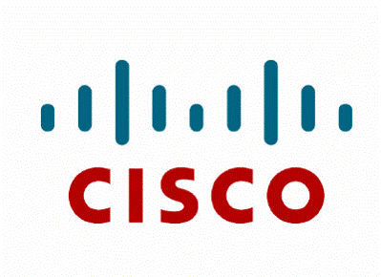













Vendors Solutions with CONNECT
Reflection Technologies
Notes:
CGI - Providing integration and implementation support.
Cisco - Offering “CONNECT in a box” packaged with Cisco router
Google - Incorporating CONNECT into its open source PHR offering
Harris - Providing integration, support services and adaptor development
Initiate - Integrating with Initiate’s master patient index by developing the customized adapter
Internet2 - Evaluating ways CONNECT can enable data exchange between rural health care providers within a region and across the country
Jericho - Developed a cross enterprise security and privacy authorization component and made it open source for the CONNECT community. The component was included in the CONNECT release 2.1
Mirth - Creating an open source healthcare integration engine for CONNECT to fast track the last mile of integration between CONNECT and edge systems
SAIC - Offering implementation support for CONNECT
Sun - Providing product support for the Sun components in CONNECT and offering integration support from CONNECT to their open source MPI.
Vangent - Created an open source XDS.b to support federated document repositories and a document registry that will be incorporated into CONNECT 2.2. The company is also offering implementation services

Slide 12
NHIN Exchange Specifications and Operational Infrastructure
Transaction Profiles
Utilize exchange patterns for specific transactions
CMS CARE
Doc Submission
CDC GIPSE
HIEM
MITA
Eligibility Verification
Discovery and Information Exchange Services
Rely on foundations to enable exchange patterns
Discovery
Pull
Push
Pub/Sub
Patient Discovery
Services Registry
Query & Retrieve Docs
Eligibility Verification
Doc Submission
HIEM
Messaging, Security, & Privacy Foundations
Enable private, secure, and interoperable communication of health information
Messaging Platform
Authorization Framework
Access Control Policy
Operational Infrastructure
Runtime systems that support the NHIN Limited Production Exchange
Security Infrastructure
(managed PKI)
Web Services Registry
Notes:
Patient Discovery – provides a means for a NHIN node to query another to determine if it is a source of information for a specific patient
Query & Retrieve Docs – an exchange pattern that allows NHIN nodes
to locate and retrieve patient-specific clinical documents held by other
NHIN nodes
Health Information Event Messaging (HIEM) – a publish/subscribe exchange pattern that allows a NHIN node to establish a subscription to information available from another for periodic exchange
Document Submission – a push mechanism that allows an initiating NHIN node to send one or more documents for a given patient to a receiving node
Services Registry Interface – provides a means for NHIN nodes to obtain information on other nodes and service endpoints
12

Slide 13
CONNECT Development Environment
Version 3.0
Item | Version
Java JRE/JDK | 1.6 Update 16 (32-bit version)
GlassFish | 2.1.1
NetBeans | 6.7.1
Metro | 1.5
MySQL | 5.1.41
SoapUI | 3.0.1

Slide 14
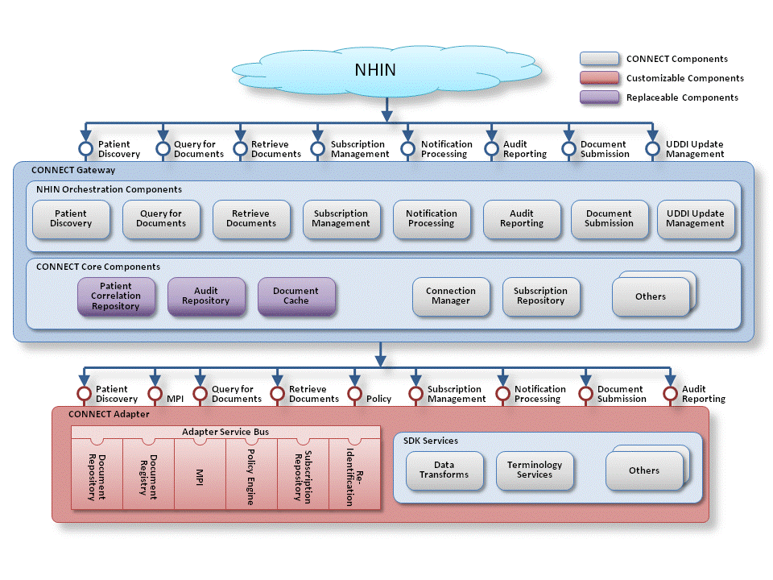
CONNECT Architecture
Message from NHIN
Notes:
Need a new pix to reflect patient discovery instead of subject discovery

Slide 15
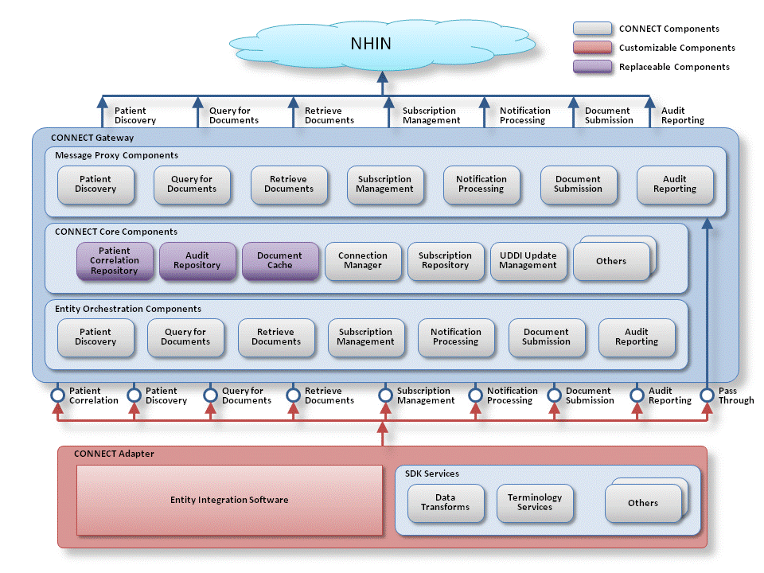
CONNECT Architecture
Message to NHIN
Notes:
Subject discovery replacement pix needed

Slide 16

CONNECT Adapter:
Organizational SOA Starter Kit
Enterprise Service Components:
  Master Patient Index
  Policy Engine
  Redaction Engine
  Audit Services
  Document Registry/
  Document Repository
  Subscription Repository
  Re-identification Service
  Entity Integration Services
  SDK Services

Slide 17

What’s cooking for CONNECT 3.1?
CONNECT Core Gateway Refactoring
  Java Library Architecture Enhancements
  Separation of Web Services and Business Logic via component proxies in Spring Framework
  Enables CONNECT portability to many environments in the future
  Enables the use of other technologies in the future e.g. REST, XMPP, SMTP, etc
  Improves CONNECT performance when adapter and gateway reside on the same machine.
  Reduces the number of web service calls
Deferred Document Retrieve and
Query Services

Slide 18

What’s cooking for CONNECT 3.1?
Large Image and File Transfer
(LiFT for Document Retrieve
Large File Support for
Document Retrieve
Logging Enhancements
Administrative DistributionService
Support for Secure and Unsecure
connectivity between the Adapter and Gateway
Performance Testing Enhancements
Automate Performance Testing as part of testing suite

Slide 19

Work anticipated in CONNECT 3.2
Support for pluggable protocols and dynamic protocol negotiation
Support for NHIN Direct
Emerging Services for Resource Management/Logistics
Emerging Services to support Meaningful Use and Health Care Reform
Identity Management Services
Semantic Services

Slide 20




Upcoming Events
August 2-5, 2010 in Washington, DC
Military Open Source Software Conference
September 7, 2010 in Washington DC
Enterprise Architecture 2010 Conference
September 21-22, 2010 in Rochester, MN
CONNECT Code-A-Thon at the Mayo Clinic

Slide 21
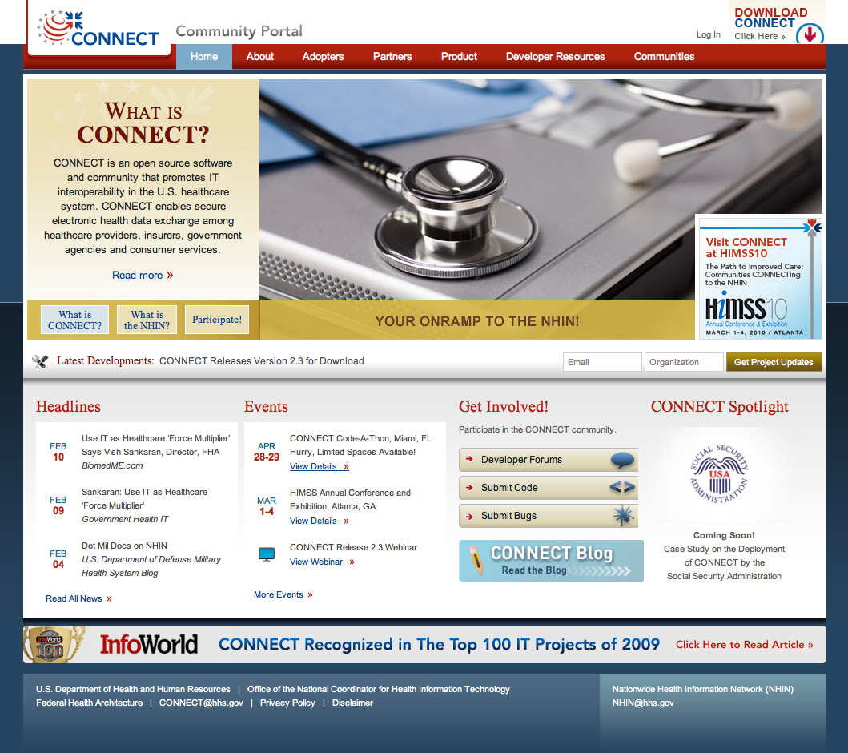
CONNECT Community Portal connectopensource.org

